Slide 1
Final Project Presentation
Prepared by: Hossain MD Farhad
Roll: 201138
Batch:22, MIT, IIT, University of Dhaka.
Project Supervisor: Dr. Kazi Muheymin-Us-Sakib,
Professor, IIT, University of Dhaka.

Slide 2
A Bengali voice enabled semantic search for air ticket booking system
It is a tool, through which a user can search flight from a flight booking website using ‘Bengali’ voice command.
A website which uses this tool will listen to user’s voice command in ‘Bengali’ language, convert the voice into text and will find the semantic meaning. Based on that, search will be initiated.
The search result will also show the price comparison among various airlines from which user can select a flight.

Slide 3
Features:
Flight search using Bengali voice command.
Price Comparison among various airlines.
Select suitable flight from result.

Slide 4
Languages, tools and technologies:
Language: ASP.NET, JavaScript.
Framework: MVC, Entity Framework.
Tools: Visual Studio, MSSQL .
Technology: Natural Language Processing.
API: Google Translate

Slide 5
Integration:
Translation
Result
Bengali Voice Input
Speech Synthesis in JavaScript
Submit to Controller by AJAX
Translate to English through API
Analyze API result
Check if the result is valid
Selects Airport/Date in the user interface

Slide 6
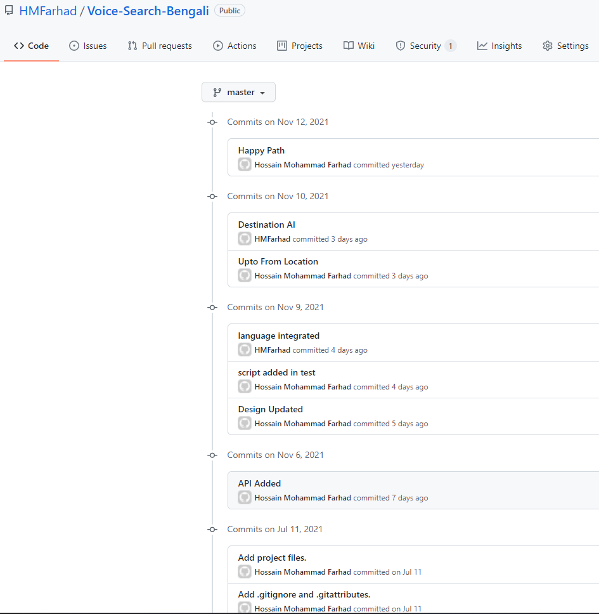
Git:
https://github.com/HMFarhad/Voice-Search-Bengali

Slide 7
Future Scope
Multi-City, Passenger details, Complete process till flight booking.
Hotel search and booking.

Slide 8
Thank You

